Slide 1

Astana IT University
Software Engineering
Final report
“School management system using SQL server”
Student: Aigerim Orumbay
Group: SE-2016
Supervisor: Aidana Kalakova
November , 2020

Slide 2
1
Outline
Introduction
Aims and objectives
Literature review
Business rules
Tables
Queries
Conclusion

Slide 3




Introduction
2
A student database management system in its simplest form uses a digital tracking system to maintain a record of all the students. It maintains a record of every student-related data ranging from personal data, examination records, courses, grades, attendance and etc.

Slide 4
3
Aims and objectives (1/2)
Project idea
Create a practical and convenient system for getting information about students and their parents. It allows to access all student-related information with ease, thus facilitating the work of school administrators and teachers.
Project task
Create the database for students who study in 10 and 11th grade that will store:
student data
attendance
exam details
grades
courses

Slide 5
Literature review (1/3)
4
School database for teachers:
Complete attendance automation
Complete marks/grade management
Interact with parents efficiently and effectively
View analytical reports
Email and Internal messaging system
View own attendance

Slide 6
Literature review (2/3)
5
School database for students:
View online marks and timetable for exams
Interaction with other students, teachers and parents
View own attendance
View timetable in advance

Slide 7
Literature review (3/3)
6
School database for parents:
Get connected with schools effectively and easily
Interact with teachers through internal messaging system.
Know status about her child through attendance, marks, fees etc ...

Slide 8
My tasks
7
Create business rules;
Create tables in SQL server;
Insert data into tables;
Write at least 10 queries: using DISTINCT, conditions (,=), OR, AND, BETWEEN, IN, LIKE, LENGHT, COUNT, MAX, MIN, SUM, AVG, INNER JOIN, LEFT JOIN, RIGHT JOIN, FULL JOIN and etc.;
Write at least 5 subqueries.

Slide 9
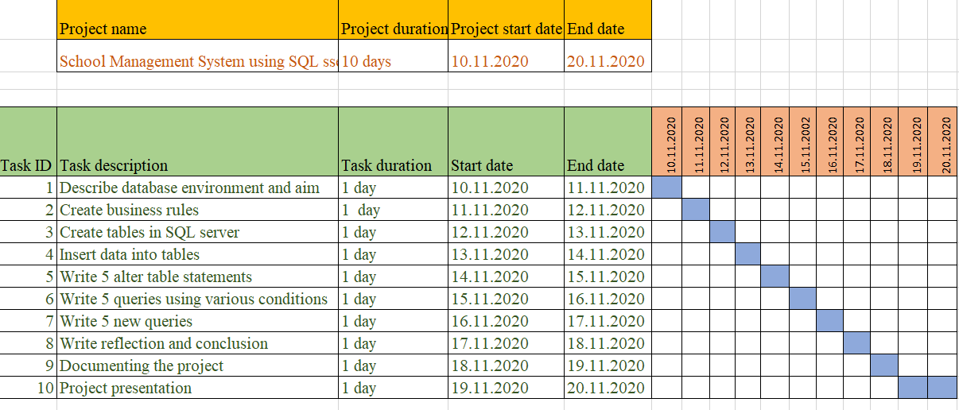
7
Gantt chart

Slide 10
9
Business rules
Student (M:1) class.
Student study in one class, class can has many students.
Class (1:1) class teacher.
Class can has one class teachers, teacher can has one class.
Class (1:1) classroom.
Class can owns one classroom, classroom belongs to one class.
Teacher (1:1) course
A teacher can teach one course, a course is tough by one teacher.
Students (1:M) grades
Students can have many grades, grades can be given to one student.
Student (M:1) parent.
Student has parents, parents can have many students(children).
Attendance (M:1) students.
Attendance belongs to one students, student has many attendances.
Student(1:M) exam
Student can pass many exam, exams are passed by one student.
Grade(M:1) final grade
One final grade is output from several grades, several grades consist one final grade.

Slide 11

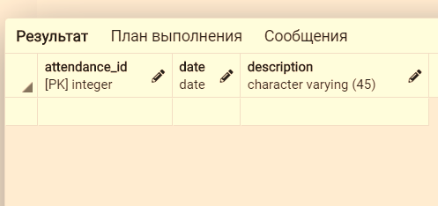
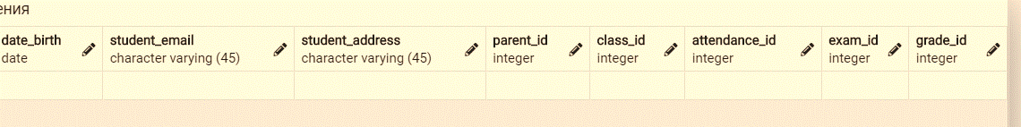
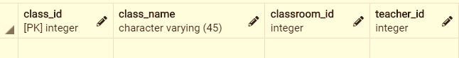
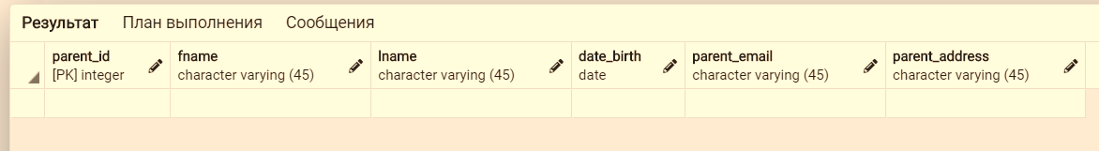
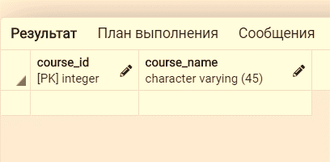

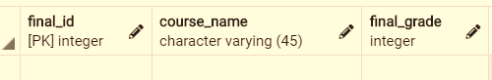

Tables (1/2)
10
Student (100records)
Attendance (100 records)
Classes (10 records)
Parent (100 records)
Course (10 records)
Teacher (10 records)
Final_grade (100 records)
Grade (100 records)

Slide 12
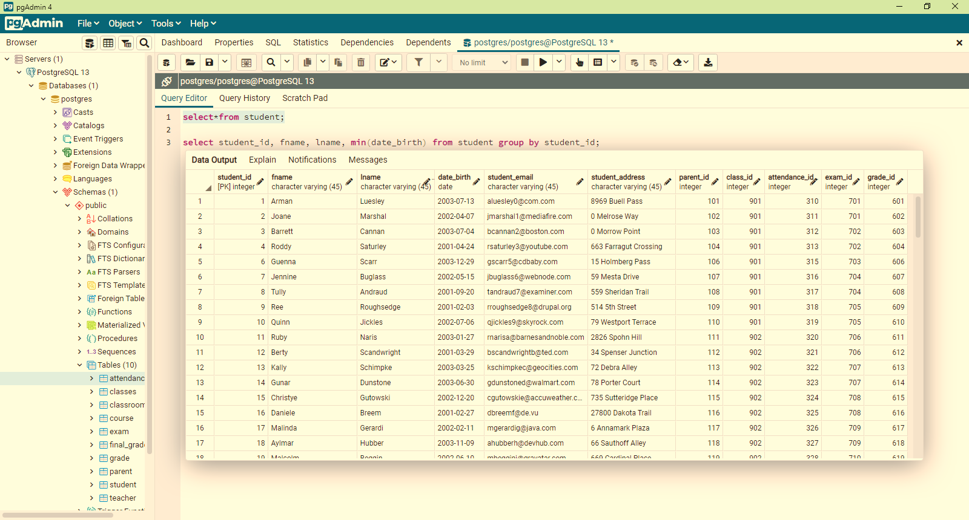
11
Tables (2/2)

Slide 13
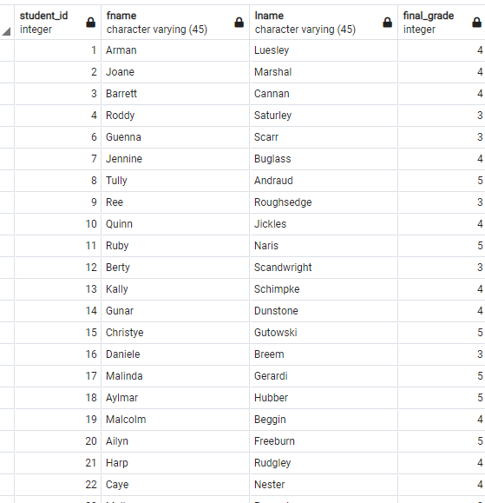
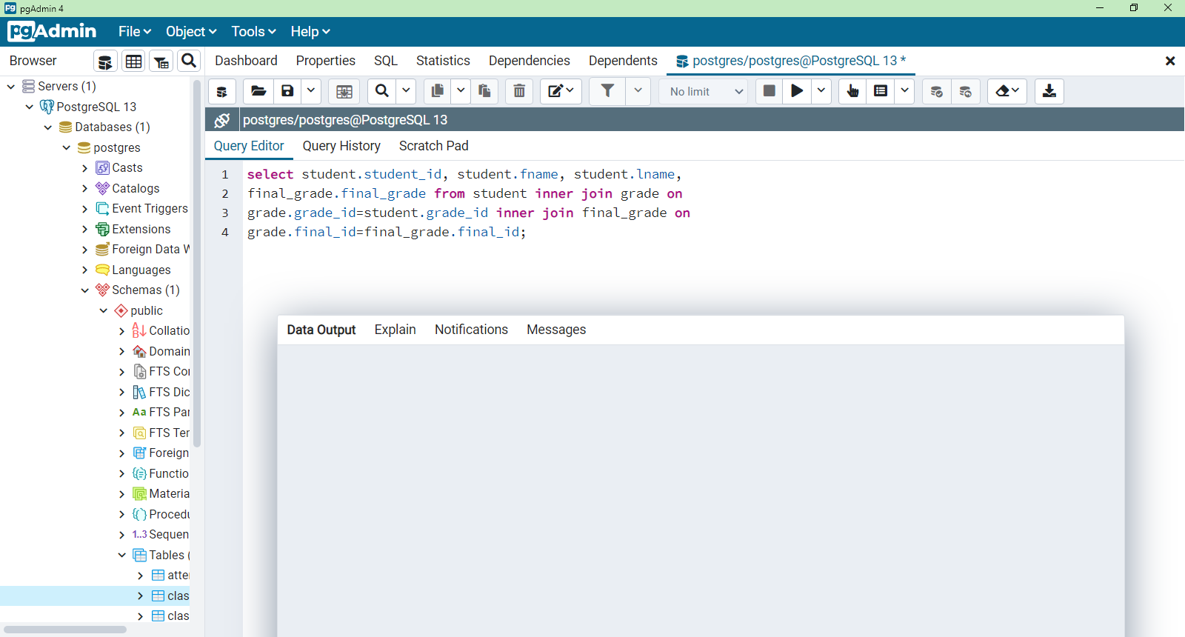
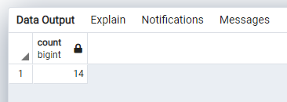
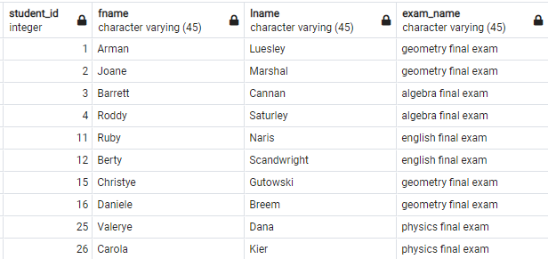
12
Queries (1/5)
Figure 3
Count how many students were absent
Figure 1
Output students’ grade
Figure 2: output description of student’s exam

Slide 14
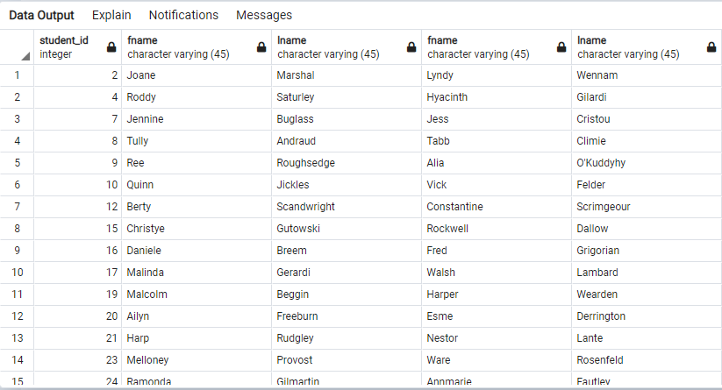
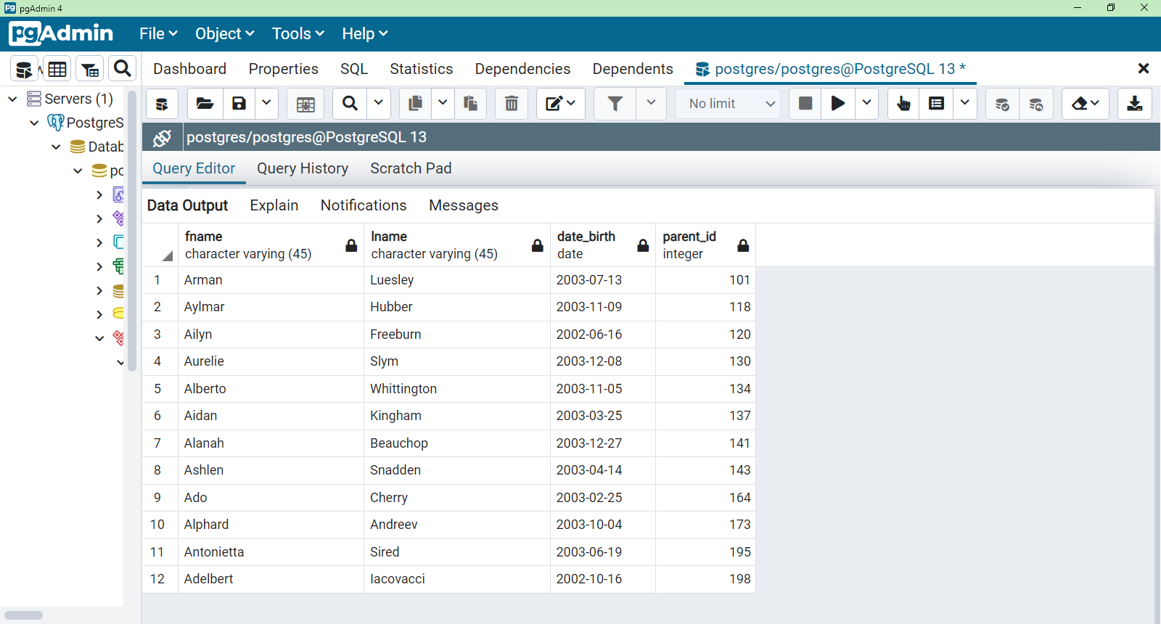
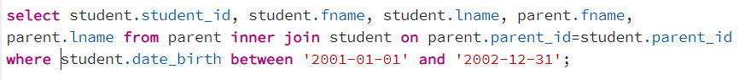
13
Queries (2/5)
Output data of student’s parents
Figure 4
Figure 5

Slide 15
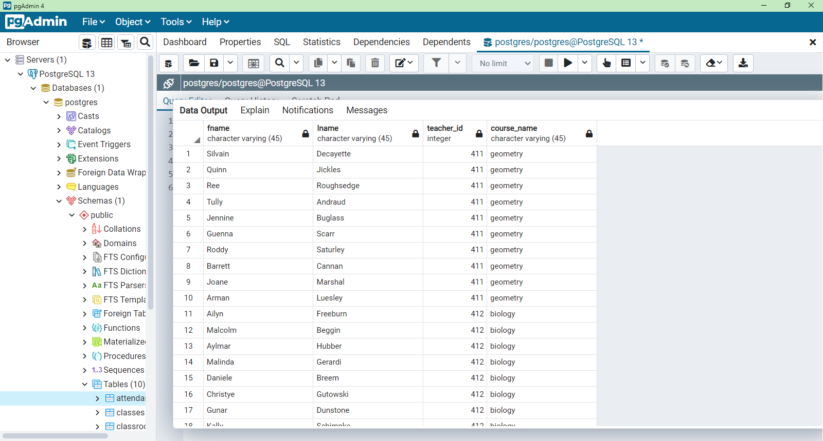
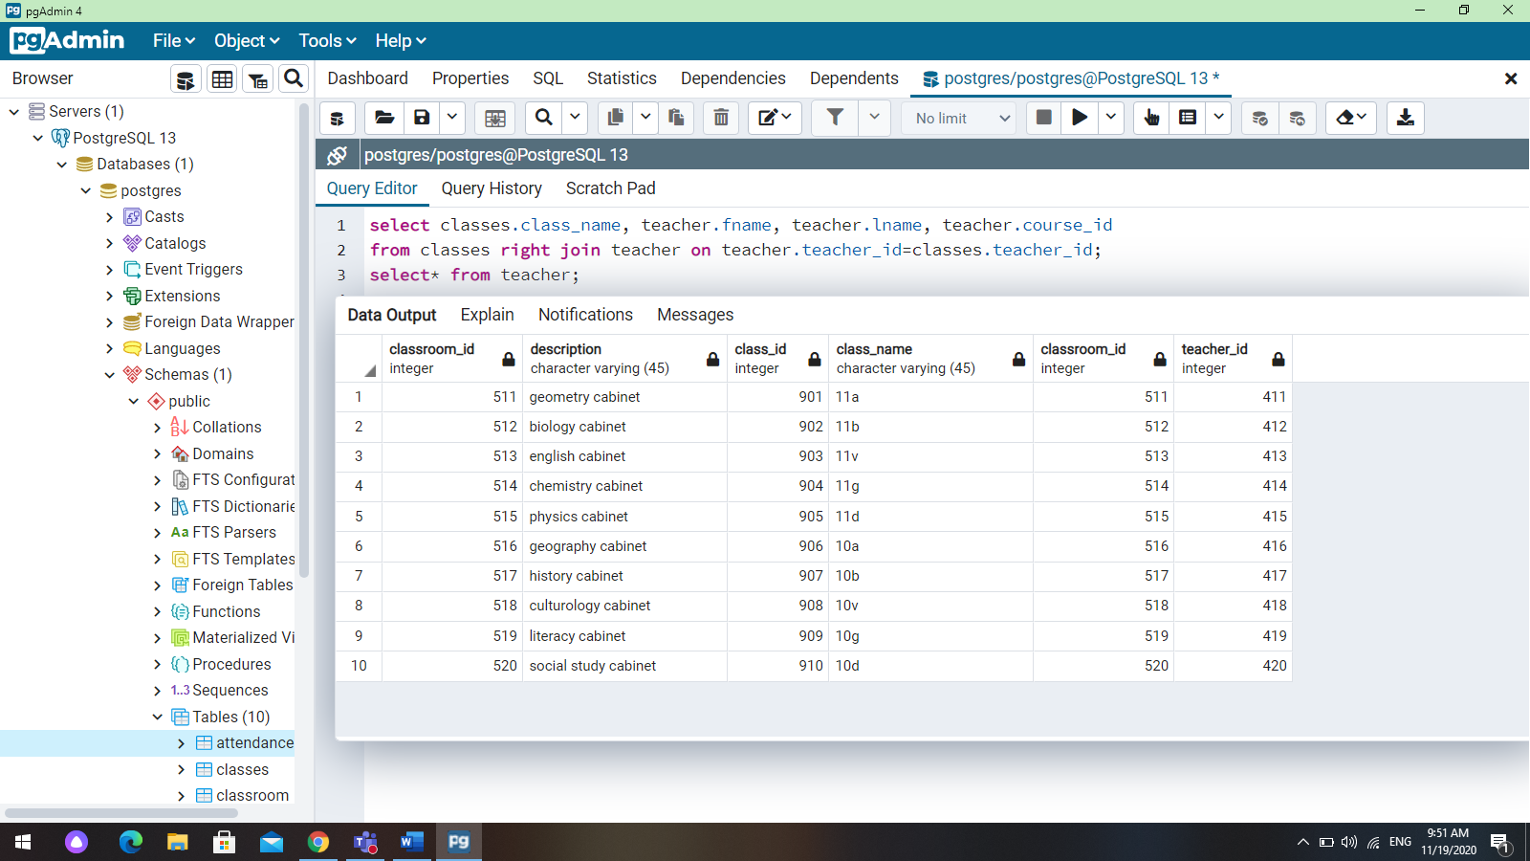
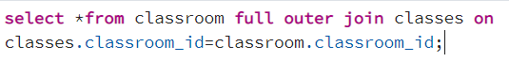
14
Queries (3/5)
Output data of classes, teachers and courses
Figure 7
Figure 6

Slide 16
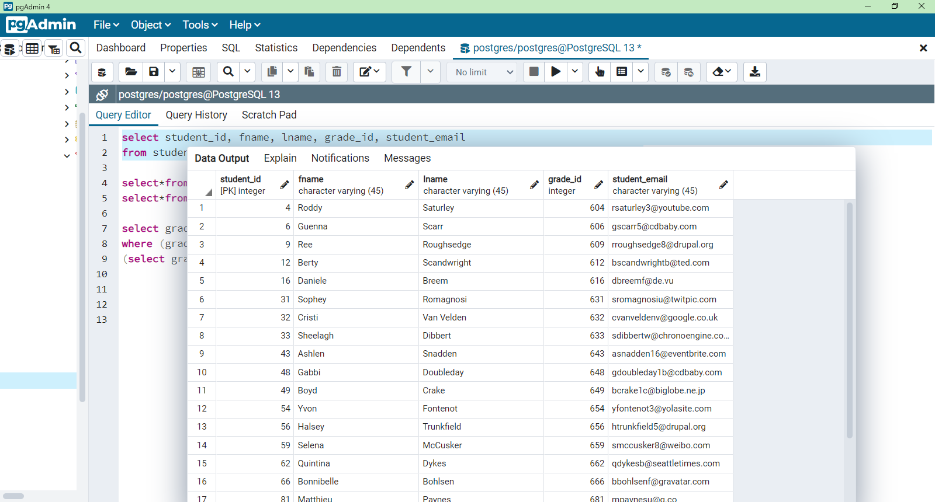
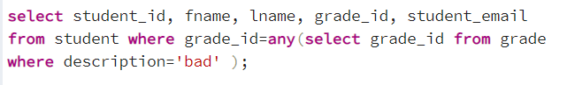
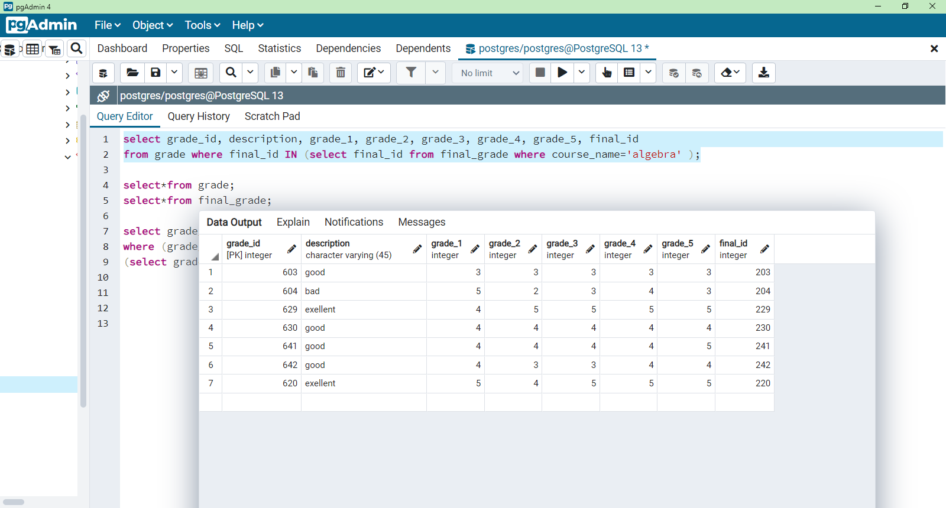
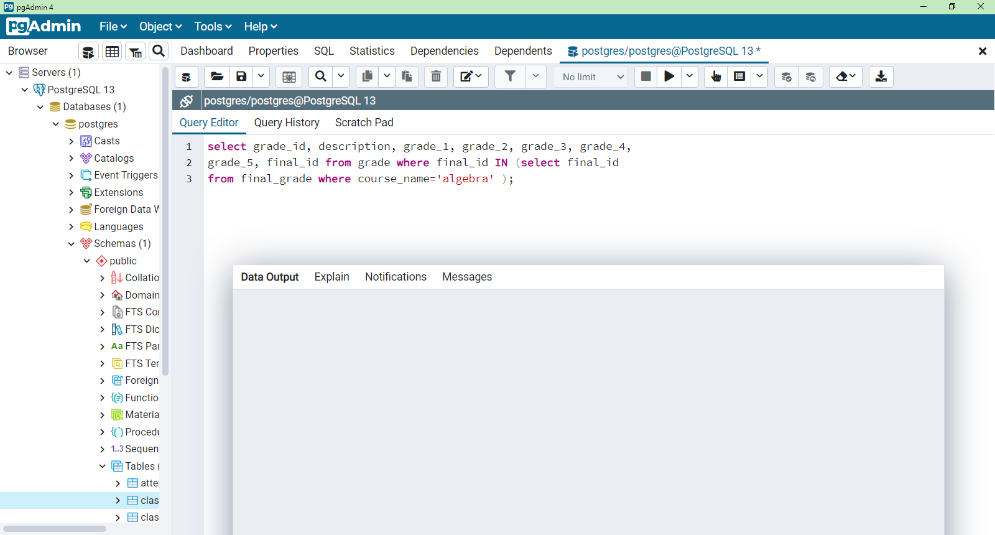
15
Queries (4/5)

Slide 17
16
Conclusion
A database is ready that stores important student data that will track their attendance and grades. This system was created only for grades 10 and 11, but it can be improved and get more data.

Slide 18
Thank you
for attention

